Slide 1
Nonparametric, Additive and Generalized Additive Models
Please install packages “mgcv”, “gam”, and” faraway” for today’s lab
Extending linear models with R 8-12 de enero 2017
UCEC, Concepción, Chile
Dr. Noble Hendrix & Dr. Cole Monnahan

Slide 2
Outline
Caveat: This is a crash course in a complex topic. Hopefully you will learn the basics of these models and how to interpret work presented by others. Bottom line: Don’t be afraid of GAMs!
Nonparametric models
What are they and why use them?
Intro to smoothers
Additive models:
How they work
How to fit them in R
Interpretation
Selection & Inference
Extensions of Additive models

Slide 3
“Big Picture”
Nonparametric Models (smoothers)
+ Multiple predictors
Additive Models
+ Non-normal response
Generalized Additive Models (GAM)
+ >1 parameter, mixed effects
GAMLSS, GAMM

Slide 4
Nonparametric regression I
Recall the big assumptions in a linear regression:
Normality
Constant variance
Independence
Explicit parametric forms
What do we do if these are violated?

Slide 5
Nonparametric regression II
Simple example model:
Parametric Approach:
Assume f is a linear function:
Or a non-linear function, e.g.:
For both of these we have to specify the mathematical form.

Slide 6
Nonparametric regression III
Simple example model:
Nonparametric Approach:
Estimate f from the data using a smoothing function (smoother)
Many smoothers exist; you already know the moving average.
Others: kernel estimators, splines, local polynomials, wavelets, etc.

Slide 7
Intro to smoothers
We will skip the (interesting) math behind these and focus on intuition
Different smoothers have pros/cons but all:
Strive to estimate f using the data
Have different parameters that control their behavior (amount of ‘wiggliness’)

Slide 8
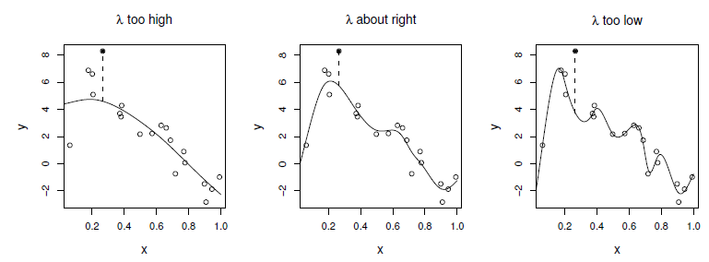
Selecting the ‘wiggliness’
Don’t want to over- or under-fit the smoother
Use Cross Validation (CV) to evaluate the degree of flexibilityin the smoother
Smoother fit without point j
Fig 3.9 from Wood (2000)

Slide 9
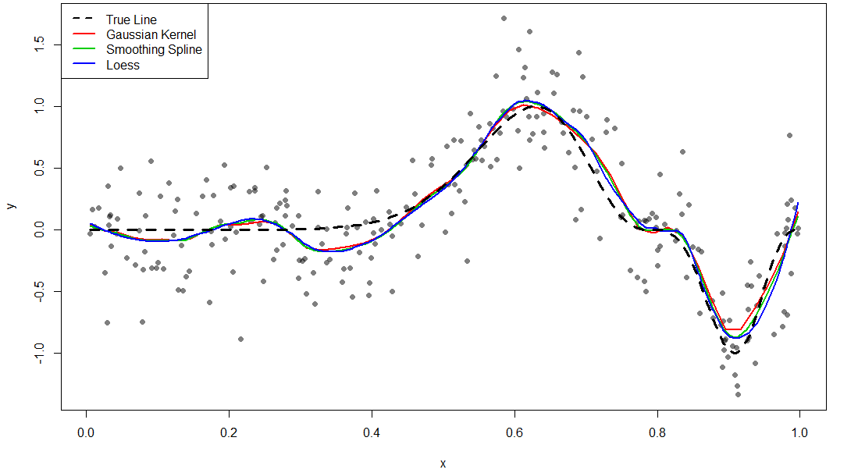
Comparing Optimal Smoother Fits
Point: The smoothers fits are (often) very similar, despite their different foundations

Slide 10
Advantages of nonparametric regression
Flexibility. We can never try all combinations of parametric functions.
No specification of form. Often we have no prior knowledge of the relationship between variables and are just guessing. This also means the analyst cannot mis-specify the model.
Investigate forms. With more covariates, it can be difficult to know which combinations of forms to try. Partial fits (more on this later) can help find these.

Slide 11
Disadvantages of nonparametric regression
Efficiency. Require more data than a properly specified parametric model.
Difficulty in interpretation. There is no explicit formula relating the dependent and independent variables.
Slower to fit. Iterative numerical solutions so no analytical mathematical solutions like LM.
Uses more degrees of freedom. If the relationship really is parametric, GLM will perform better.

Slide 12
Additive Models I
What happens with more than one covariate?
Parametric Linear: Always an option!
Multivariate Nonparametric:
High data requirements, but handles interactions
Additive Model: Linear combinations of univariate nonparametric terms:

Slide 13
Additive Models II
More flexible than linear models, but less so than multivariate (MV) nonparametric.
Marginal relationships (f_{j}’s) can be plotted for interpretation, unlike multivariate nonparametric
Will do poorly when strong interactions exist
Can be a mix of parametric and nonparametric terms:
Nonparametric terms
Parametric terms

Slide 14
Additive Models III
In R there are two main packages: gam and mgcv
gam is the original based on Hastie and Tibshirani (1990). It allows more choices for smoothers and uses backfitting.
mgcv of Wood (2000) is more common. It uses penalized smoothing splines and has an automatic selection of smoothing.
Both packages use the function gam, which has the same syntax as glm.

Slide 15
Backfitting
The backfitting algorithm used in the gam package nicely introduces some important concepts with additive models:
Fitting them is complicated
“Partial residuals” are integral to thinking about these models. These are the residuals when everything but a predictor j is included in the model.
The algorithm fits a single predictor to the partial residuals, then moves on to the next predictor. This process is repeated until it converges.
The following slides show the iterative process.

Slide 16
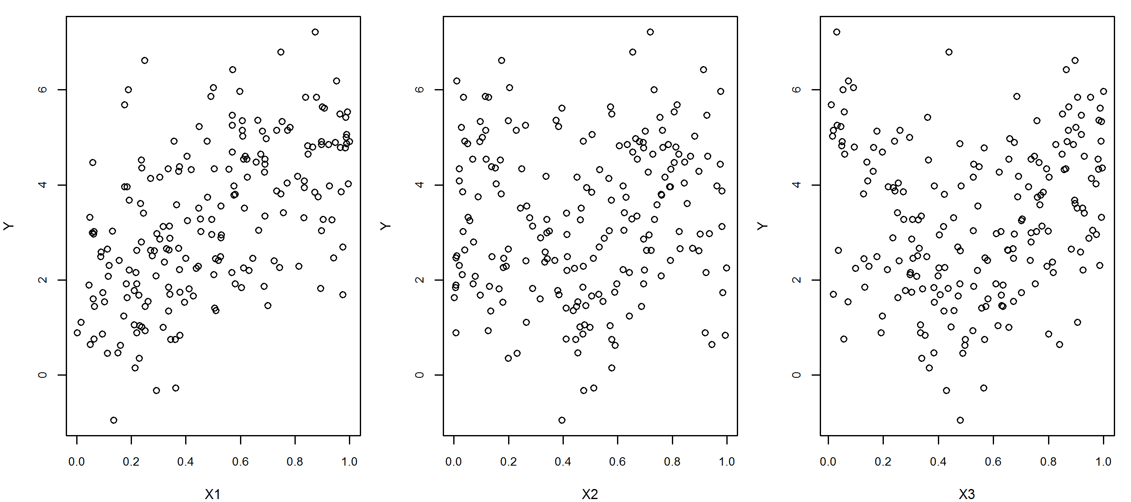
Demonstration of Backfitting
Contrived, randomly generated data. Do you see the relationships?

Slide 17
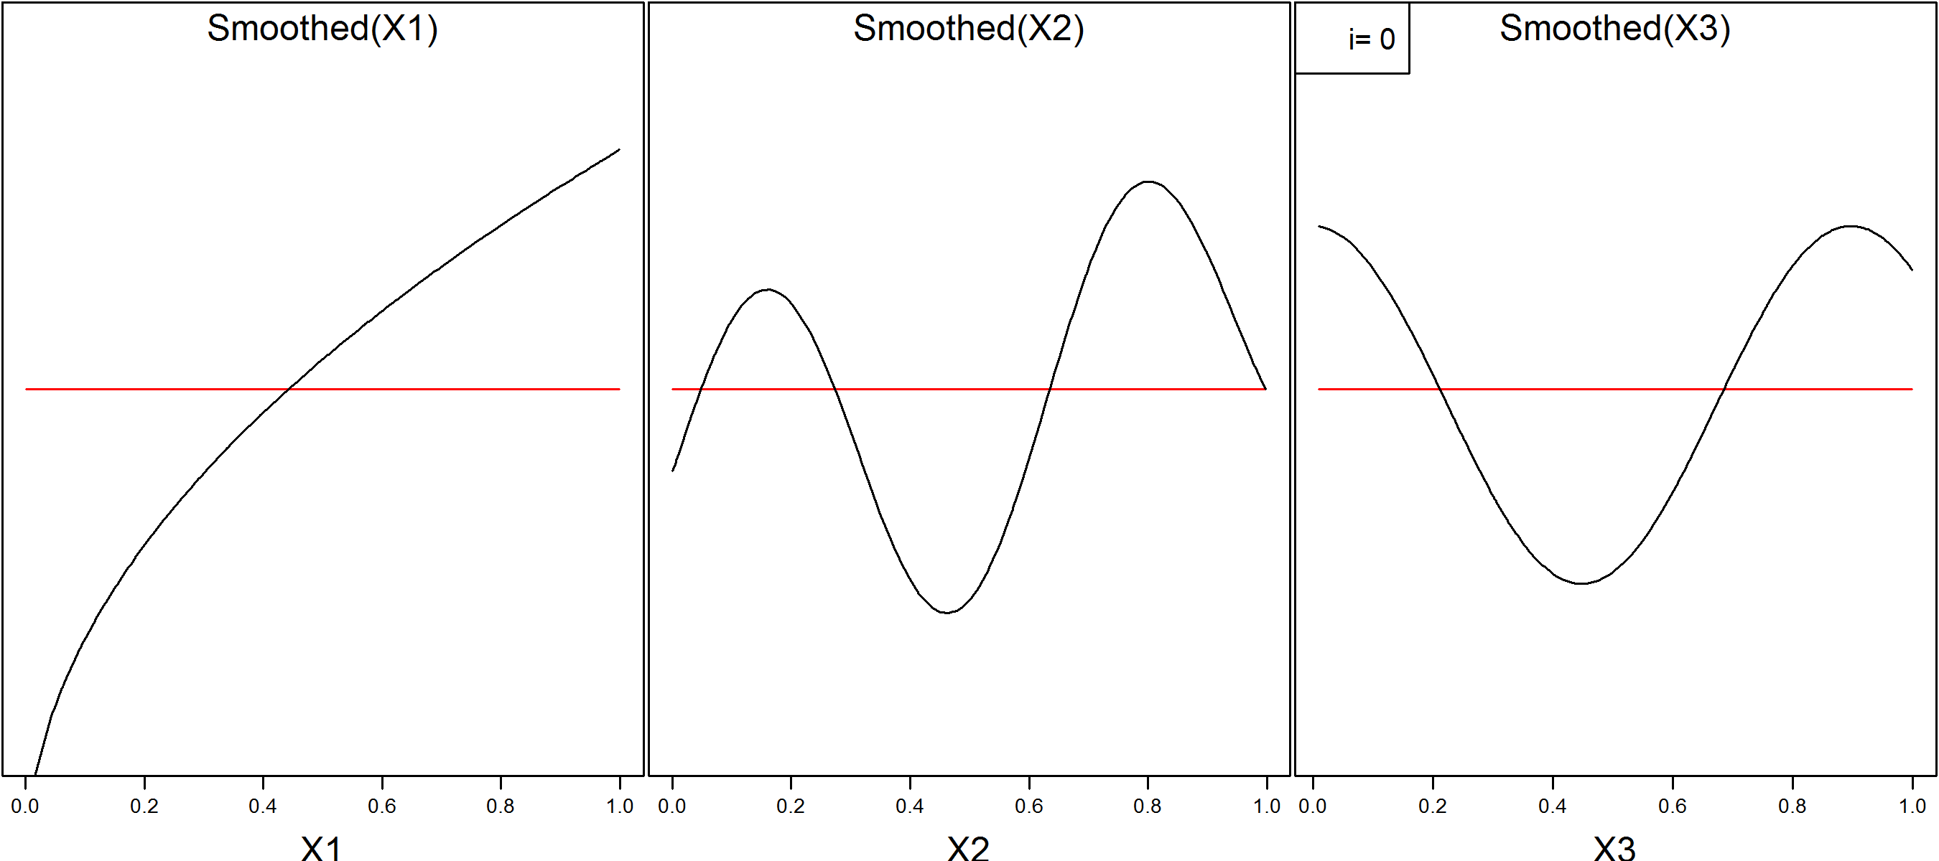
Demonstration of Backfitting
Initialize with zero slopes. Could also start from a linear model.
Smoother
Truth

Slide 18
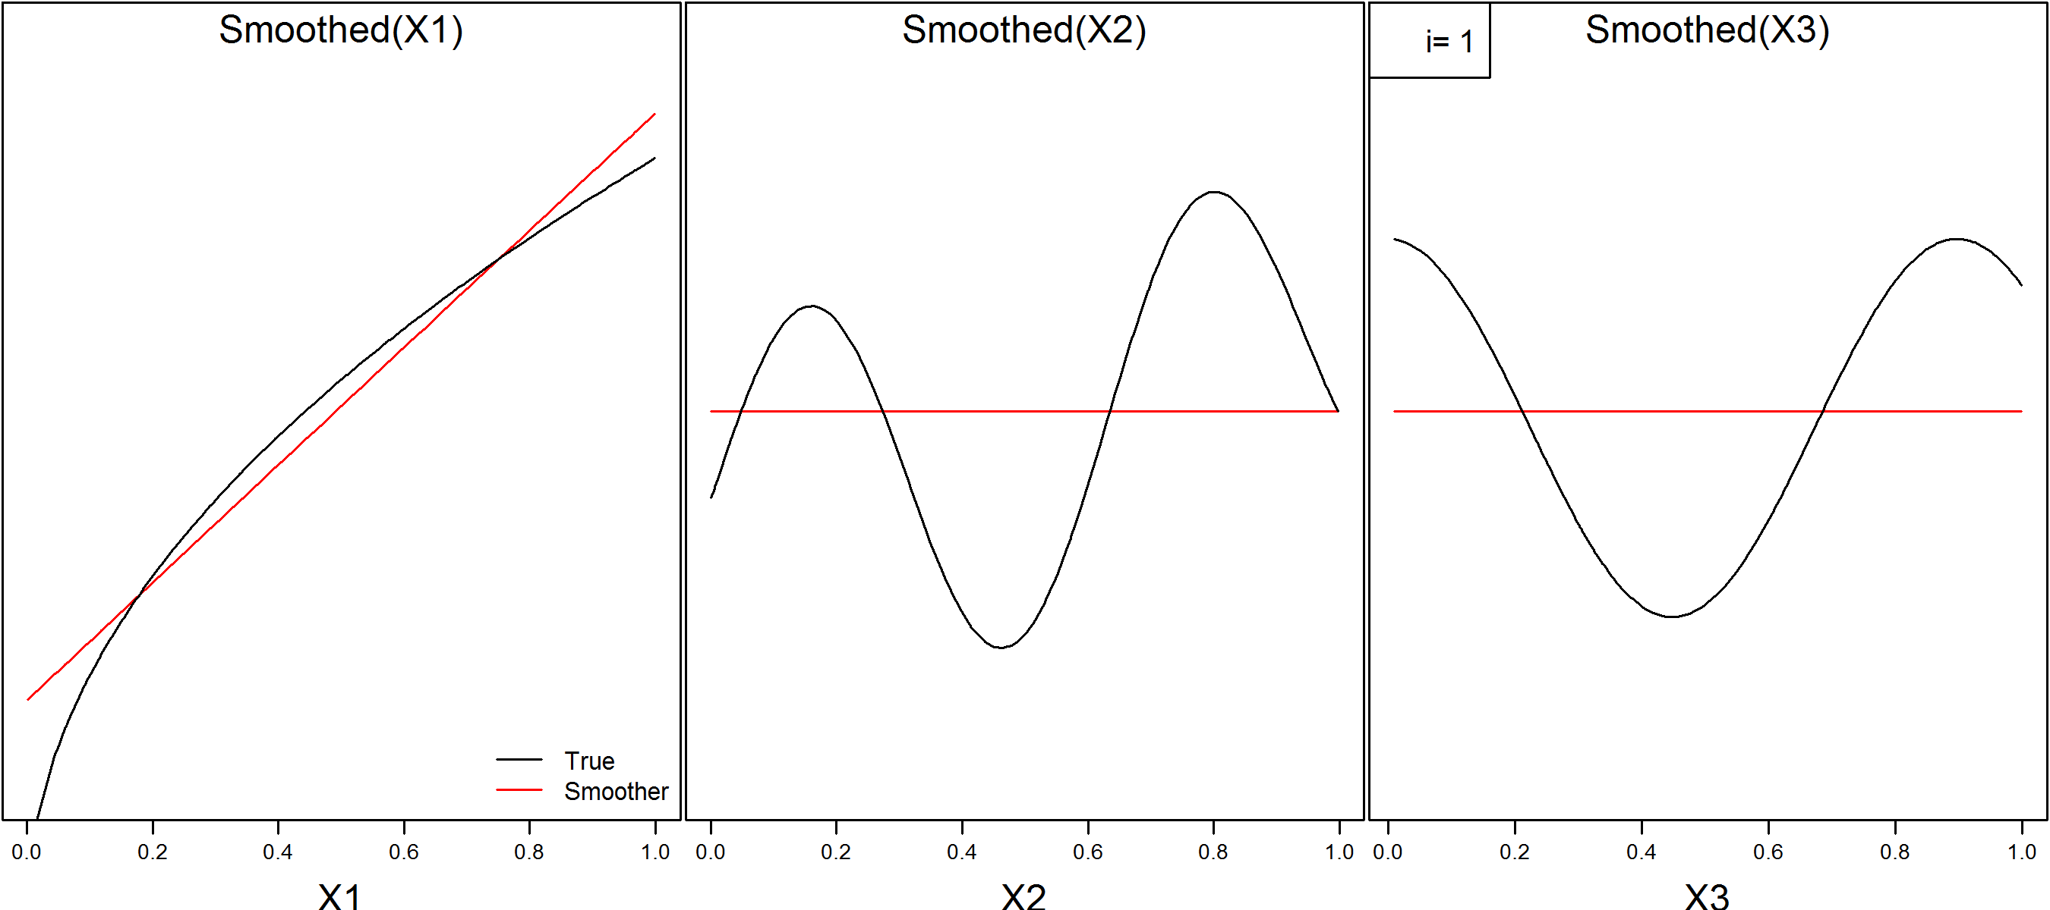
Demonstration of Backfitting
First iteration: Fit smoother to partial residuals for X1

Slide 19
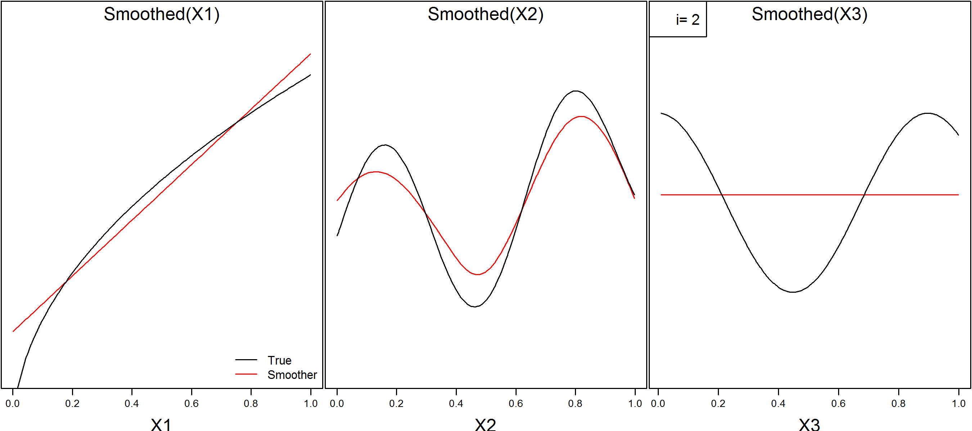
Demonstration of Backfitting
Second iteration: Fit smoother to partial residuals for X2

Slide 20
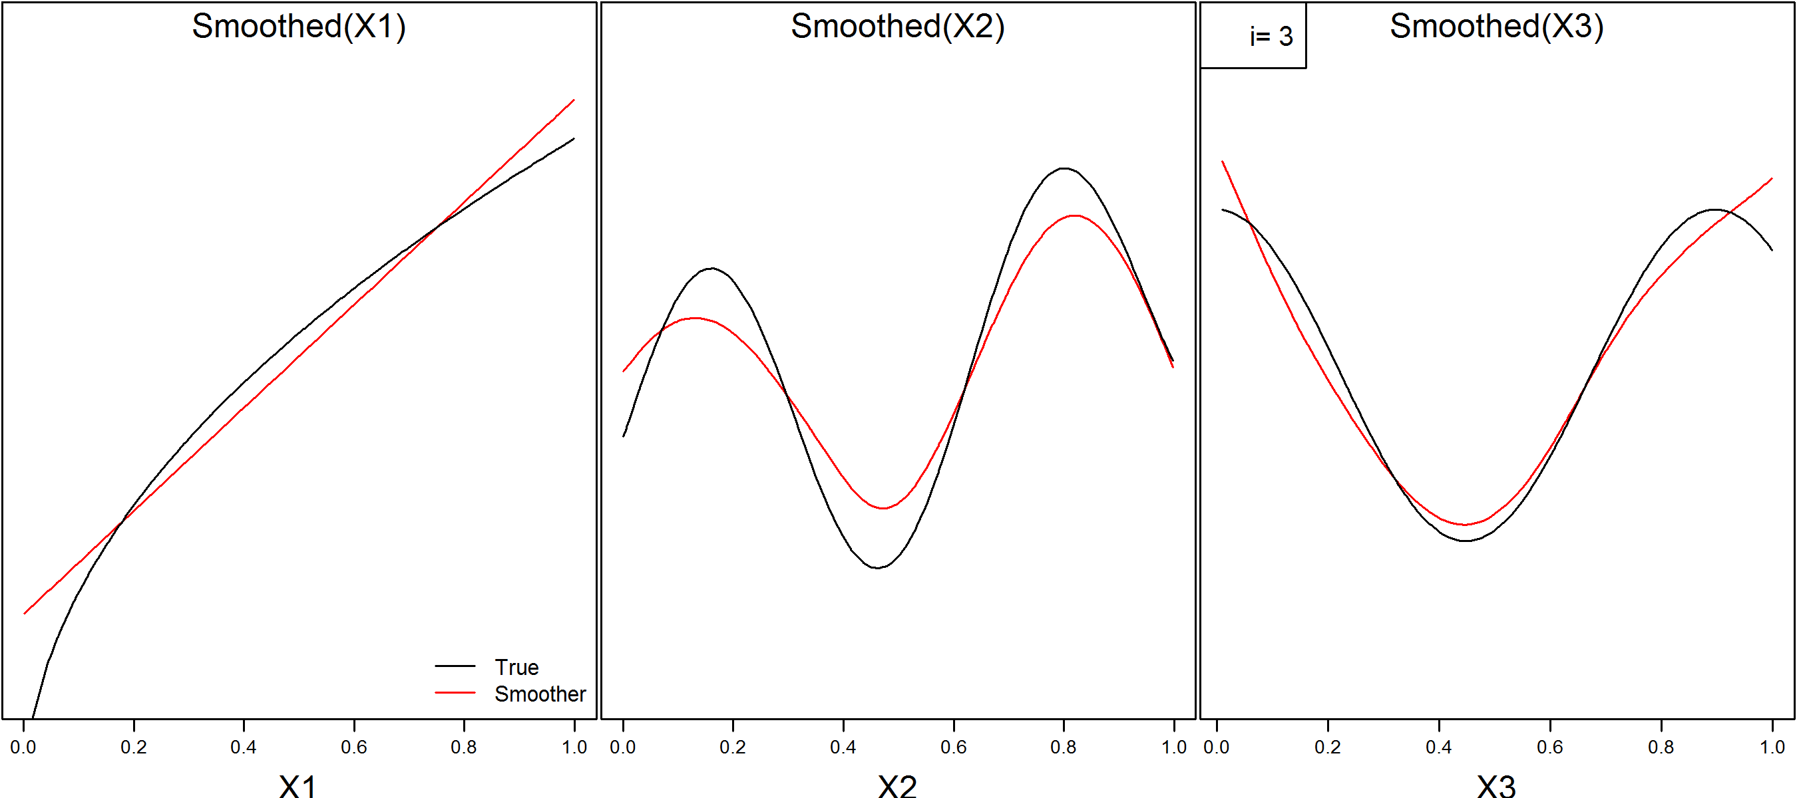
Demonstration of Backfitting
Third iteration: Fit smoother to partial residuals for X3
The algorithm then comes back to X1 and repeats until converged.

Slide 21
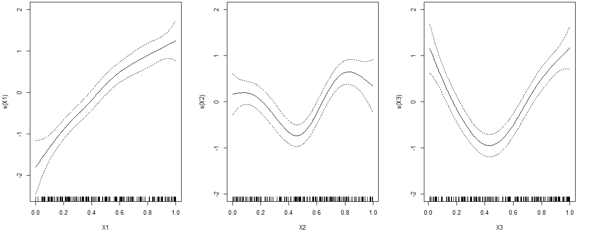
Partial Residuals
Remember: the smoothers fit to the partial residuals. This is also how to inspect an additive model:
mod.gam <- gam(Y~s(X1)+s(X2)+s(X3))
plot.gam(mod.gam, se=T, ylim=c(-2,2))

Slide 22
Partial Residuals II
The absolute value of the smoothers are arbitrary: add a constant to one and subtract it from another and the fit is identical
So we care about the relative values: how much does it span the y-axis?
For this reason, partial fits should always be plotted on the same y-axis scale (as in previous plot).
Bottom line: Fits that span more of the y-axis have more influence.

Slide 23
Model Selection & Inference
df are approximated by analogy to LMs, and may not be whole numbers!
Faraway states: “[predictor] p-values are only approximate at best and should be viewed with some skepticism” (p.234) –i.e. the p-values in the summary() command aren’t reliable
Instead he recommends using F-tests like with GLMs: anova(gam1,gam2, test=“F”)
These tests are also approximate, but ‘better’ than the predictor tests.
Can test whether to include predictor variable, or whether it should be additive*
Predictions can be made, but SEs are approximate and extrapolation is unreliable (why?)
AIC can be used for non-nested models.
*Sometimes an additive fit gives clues about a parametric form to try

Slide 24
Generalized Additive Models
Naturally these models can be extended.
GLM : LM as GAM : additive
The same packages and commands are used for GAMs.
The same tools/ideas from GLMs apply to GAMs (e.g. link functions, overdispersion)
A GLM is a special case of a GAM where none of the terms are nonparametric

Slide 25
Extensions of GAMs
Multivariate smoothers
I.e. instead of f_{j}(X_{j}) + f_{k}(X_{k}) we could model f_{jk}(X_{k},X_{k}) directly. This will capture interactions better.
GAMLSS¹:GAM for location, scale and shape
Allows for wider family of distributions and to model each parameter additively (e.g. beta-binomial)
Allows for zero-inflated models
GAMM: Generalized Additive Mixed Model (mgcv)
Allows mixed (random + fixed) effects
¹Stasinopoulos, D. Mikis, and Robert A. Rigby. "Generalized additive models for location scale and shape (GAMLSS) in R." Journal of Statistical Software 23.7 (2007): 1-46.

Slide 26
Summary
GAMs are extremely flexible models that are indispensable in some scenarios, but they come with disadvantages and should be used judiciously. Use a parametric model when possible!
The same modeling philosophy applies: analysts should use their biological knowledge to guide model building and selection (see Burnham & Anderson 2002).
Examine partial fits: that is the only way to interpret these models – there is no formula!
Plot partial fits on the same scale, and be wary of extrapolating.
Side note: Be careful of overloading functions when using both gam and mgcv. I.e., they both have functions with the same names but that are different, e.g. the gam() function

Slide 27
Further Reading
These notes were based on Faraway’s Extending the Linear Model with R’s nice introduction (chapters 11-12)
Wood, Simon N. Generalized additive models: an introduction with R. Vol. 66. Chapman & Hall, 2006.
Good background on how splines work with examples in R using mgcv

